Slide 1





Processing large social media datasets on HAWK
Sefa Ozalp
Data Science Researcher, HateLab
11 February 2020
ARC HPC Research Seminar
@SefaOzalp

Slide 2
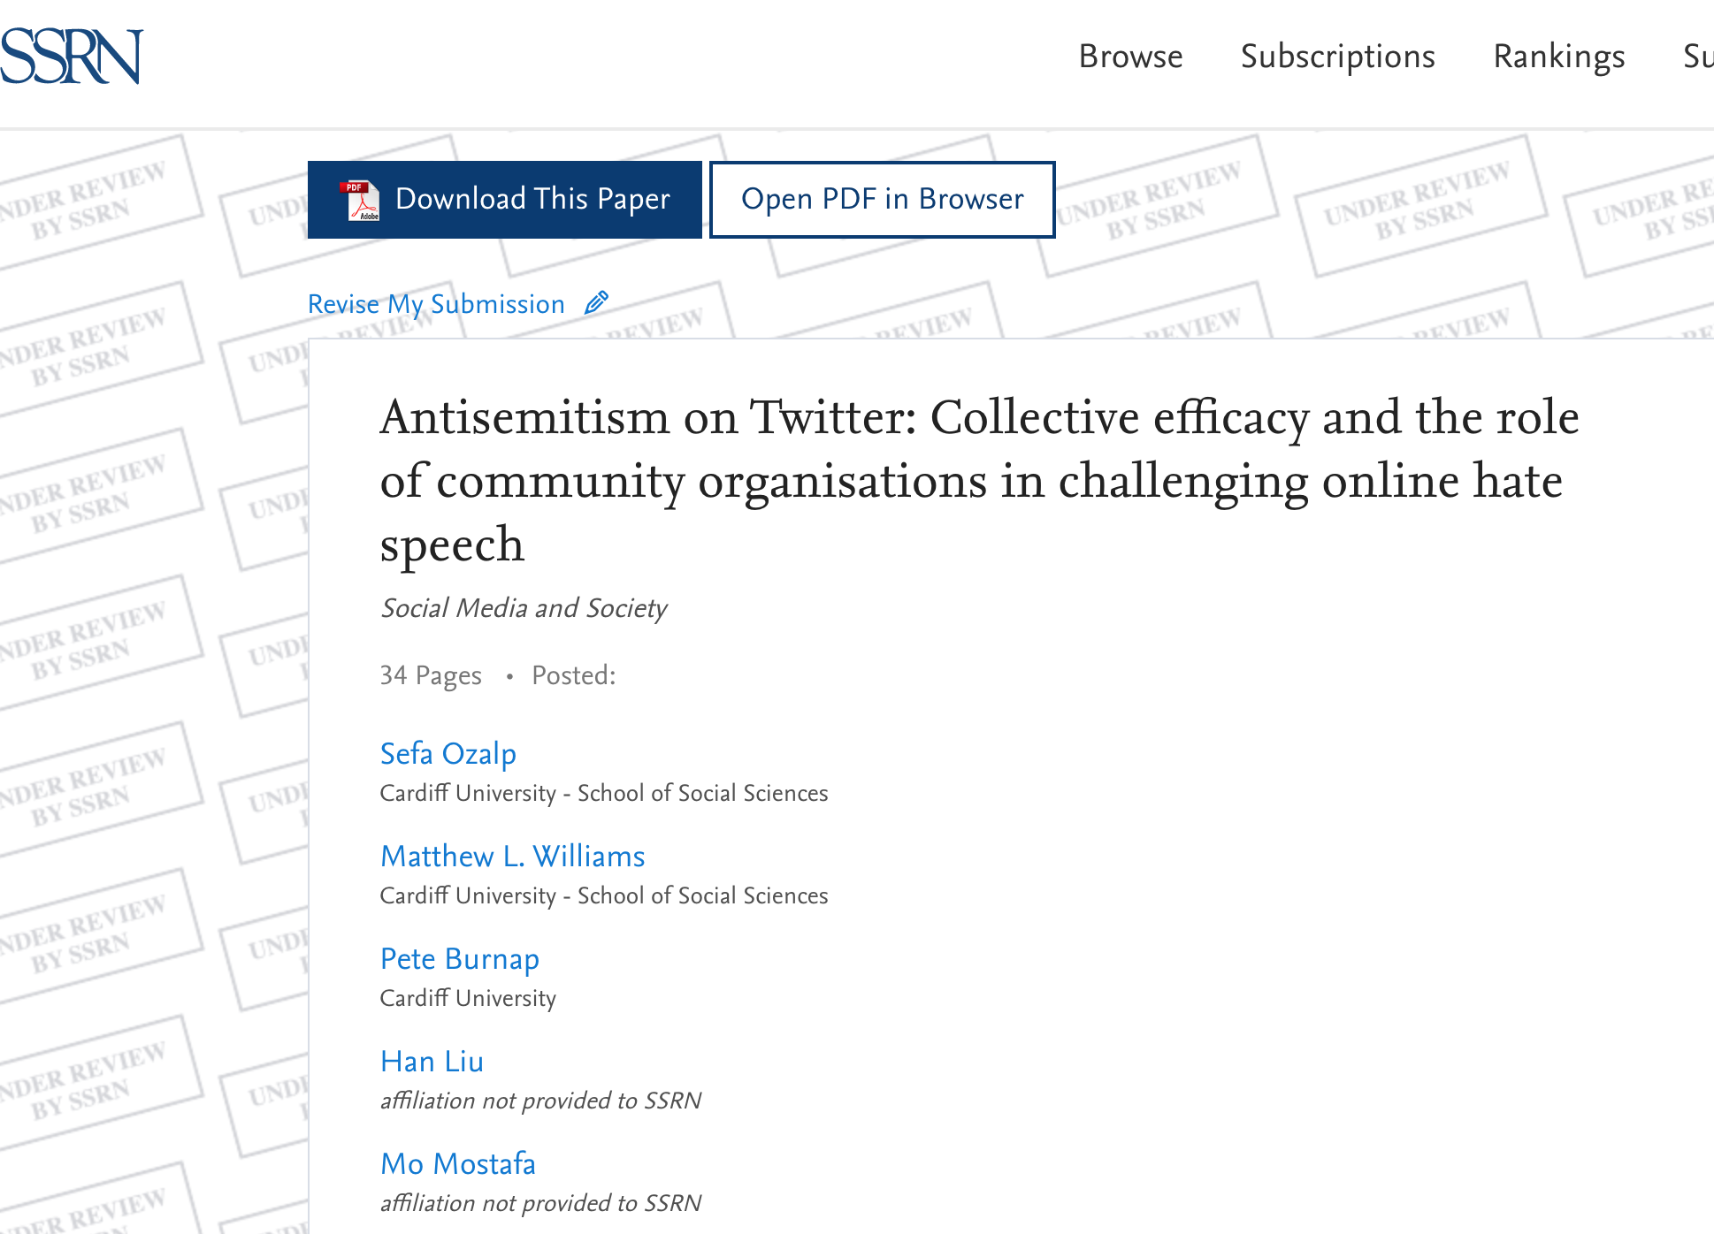
https://papers.ssrn.com/sol3/papers.cfm?abstract_id=3532492

Slide 3
The Number of All Tweets vs Antagonistic Tweets

Slide 4
The Number of Antagonistic Tweets

Slide 5
Antisemitic Tweet Classification Results
Event 1
Event 2
Event 3

Slide 6
Technology Stack

Slide 7
Data Collection
Data collected from Twitter stream filter API using keywords of interest. We use COSMOS software developed by Social Data Science Lab http://socialdatalab.net/COSMOS.
A dataset I’m collecting since November 2016 using keywords:
‘muslim, muslims, islam, refugee, refugees, immigrant, immigrants, immigration, migrants, migrant, migration, jew, jews’
Data comes in hourly .jsonl chunks, ranges between 4.3 Mb on disk and 1.2 GBs on disk.

Slide 9
Problem with Large Twitter Data (For a social scientist)
Json data are hierarchical (strong dislike)
Parsing data into 2D tabular format takes really long.
When parsing, Json objects tend to expand in memory (by a factor of 20)
Flattened tweet object can contain more than 3500 columns
A tweet json object can contain thousands of fields (demo in VS code)
27296 hourly chunks.
Total size of the data are 6.6TB
Total number of tweets are 1124710581 (rough estimate)

Slide 10
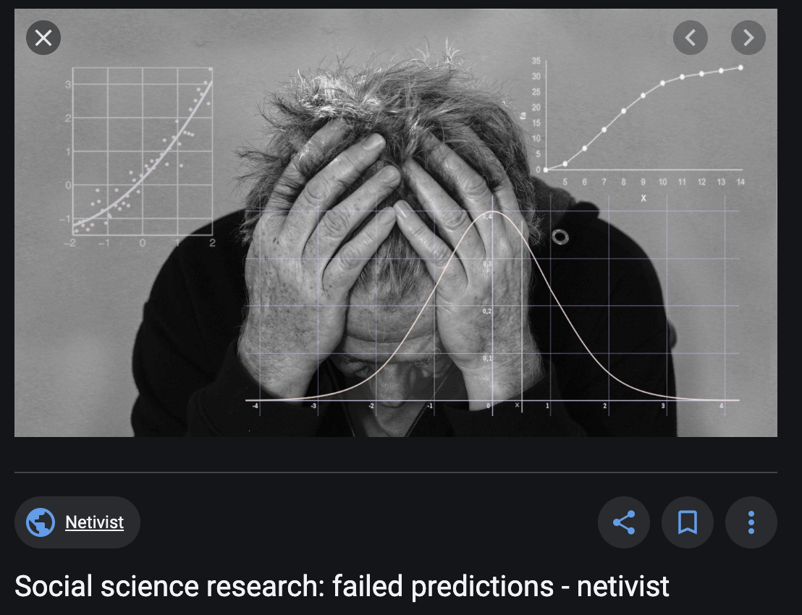

Slide 11
HAWK to the rescue.
- Pushing data to SCW servers
Writing my own functions and then eventually my own R package rather than calling scripts.
https://github.com/sefabey/tweetWrangleR/ (still fails travis CI)
Use highmem cluster on HAWK and handle parallelisation in R using {furrr} package.

Slide 12
Processing large social media datasets on HAWK
Sefa Ozalp
Data Science Researcher, HateLab
11 February 2020
ARC HPC Research Seminar
@SefaOzalp

